Slide 1

Next-Generation Hybrid Deep Learning and Machine Learning Model with Transformer-Based NLP Embeddings for Early Detection of Chronic and Lifestyle-Related Diseases
MAJOR PROJECT REVIEW-2
Name : Hemanth Kumar Pattem (Reg. No. 24691F0071)
Project Guide : Dr. J. SRINIVASAN JAGANNATHAN, M.C.A., Ph.D.,

Slide 2

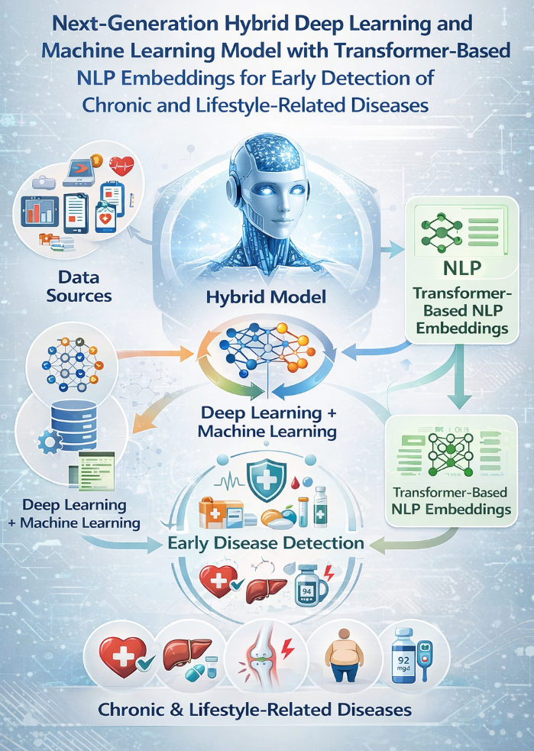
Table of contents
Project Title & Domain
Problem Statement
Objectives
Literature Survey Summary
Proposed Methodology/Architecture
Tools/Technologies to be Used
Explanation of ER, UML and DFD diagram
Software Requirement Specification
Timeline for Future Work

Slide 3
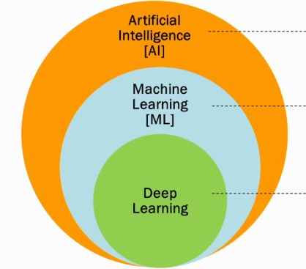
1. Project Domain
Artificial Intelligence in Healthcare
Machine Learning & Deep Learning
Natural Language Processing (NLP)
Explainable AI (XAI)

Slide 4
2. Problem Statement
Chronic diseases such as diabetes, heart disease, and hypertension are increasing rapidly and have become a major health concern. Early detection of these diseases is challenging because medical data is often complex and existing systems do not provide personalized analysis for patients. Most traditional models focus only on structured data and tend to ignore important clinical text like medical reports and doctor’s notes. Therefore, there is a need for a more accurate and interpretable system that can combine both structured and unstructured data using a hybrid prediction model for better early detection.

Slide 5
3. Objectives
Develop a hybrid ML + DL model for disease prediction
Use Transformer-based NLP embeddings for text data
Improve prediction accuracy and F1-score
Provide explainable results using XAI techniques
Enable early detection and personalized insights

Slide 6
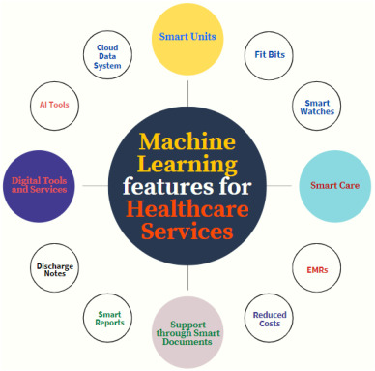
4.Literature Survey
Traditional Methods:
Logistic Regression
Decision Trees
Limitations:
Low accuracy
Cannot handle complex patterns
Machine Learning Models:
Random Forest
Support Vector Machine

Slide 7
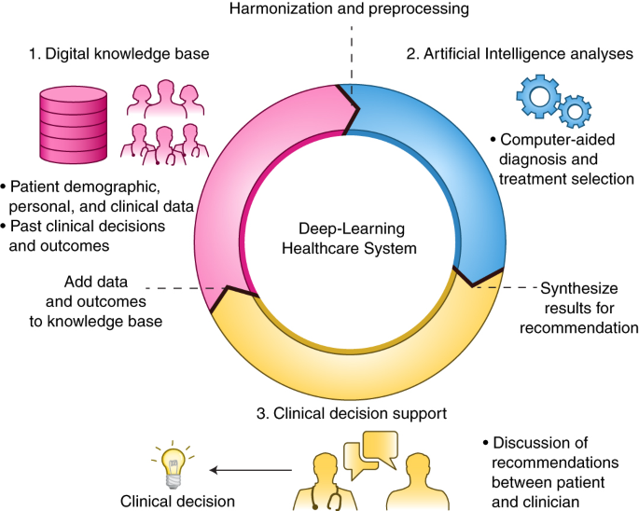
4.Literature Survey
ML Limitations:
Limited feature understanding
Deep Learning Approaches:
LSTM for sequential medical data
CNN for feature extraction

Slide 8
4.Literature Survey
Deep Learning Limitations:
Lack of interpretability
Poor handling of text data
Conclusion:
Hybrid models improve performance
NLP embeddings enhance text understanding
Combination leads to better accuracy and prediction

Slide 9
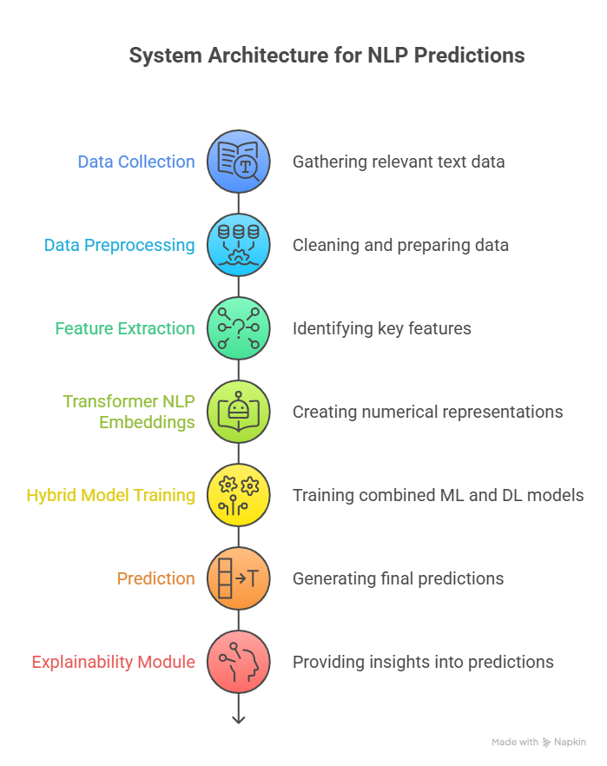
5. System Architecture

Slide 10
5. System Architecture
Represents the overall workflow of the proposed system
Data is collected from multiple sources:
Structured data (medical records)
Unstructured data (clinical text, reports)
Data preprocessing is performed:
Cleaning noise and missing values
Feature extraction techniques used:
TF-IDF
NLP embeddings
Transformer-based embeddings capture text meaning
Processed data is fed into the hybrid model
Hybrid model generates predictions
Explainability module (SHAP/LIME) provides interpretation of results

Slide 11
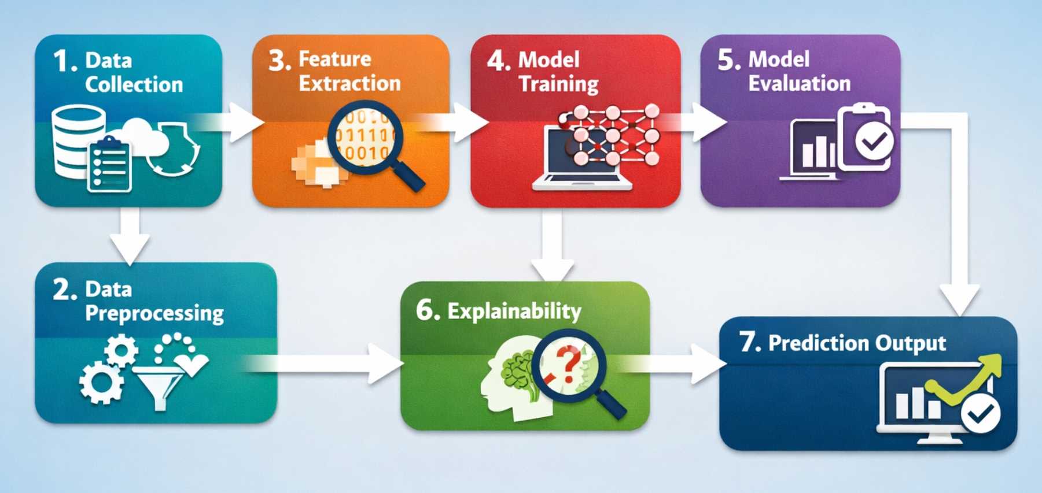
6. Proposed Methodology

Slide 12
6. Proposed Methodology
Step-by-step process to build the proposed system
Collect both structured and unstructured data
Clean and preprocess the data to ensure quality
Apply feature extraction techniques (TF-IDF and embeddings)
Train hybrid model combining ML and DL techniques
Evaluate model using accuracy and F1-score
Use SHAP and LIME for explainability
Generate final prediction output for disease detection

Slide 13
7. Tools & Technologies
Programming Language: Python
Libraries:
Scikit-learn
TensorFlow / Keras
Pandas, NumPy
NLP:
Transformers
Visualization:
Matplotlib, Seaborn

Slide 14
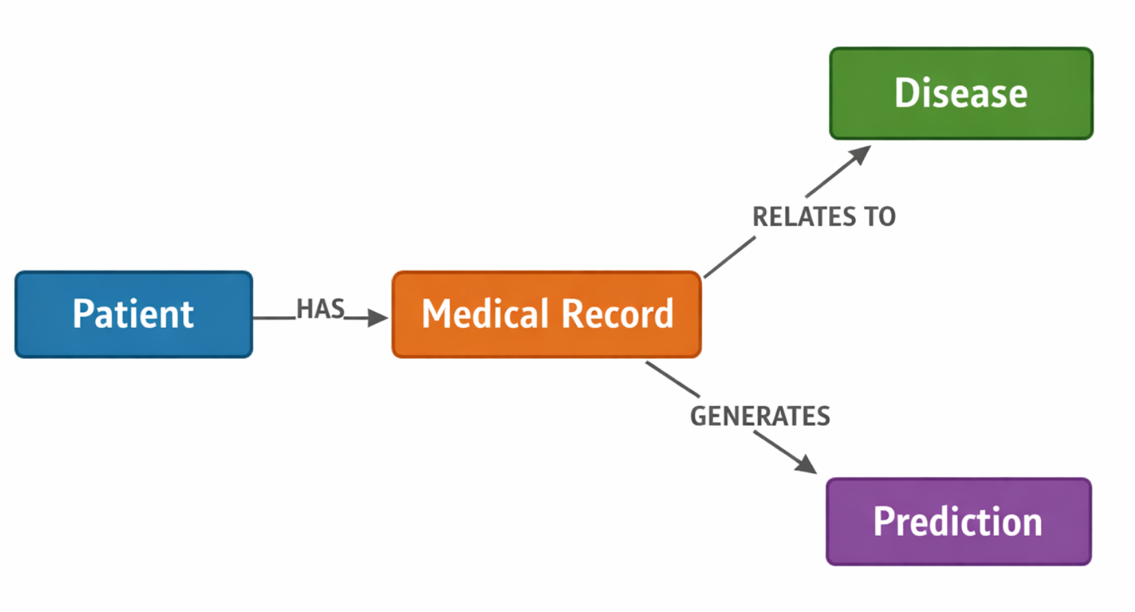
8. ER Diagram

Slide 15
8. ER Diagram
Relationships Between Entities
Patient → Medical Record (HAS)
Each patient has one or more medical records.
This shows data collection from patients.
Medical Record → Disease (RELATES TO)
Medical records are linked to specific diseases.
Helps in identifying existing or past health conditions.
Medical Record → Prediction (GENERATES)
The system uses medical records to generate predictions.
Prediction is based on ML/DL models analyzing the data.

Slide 16
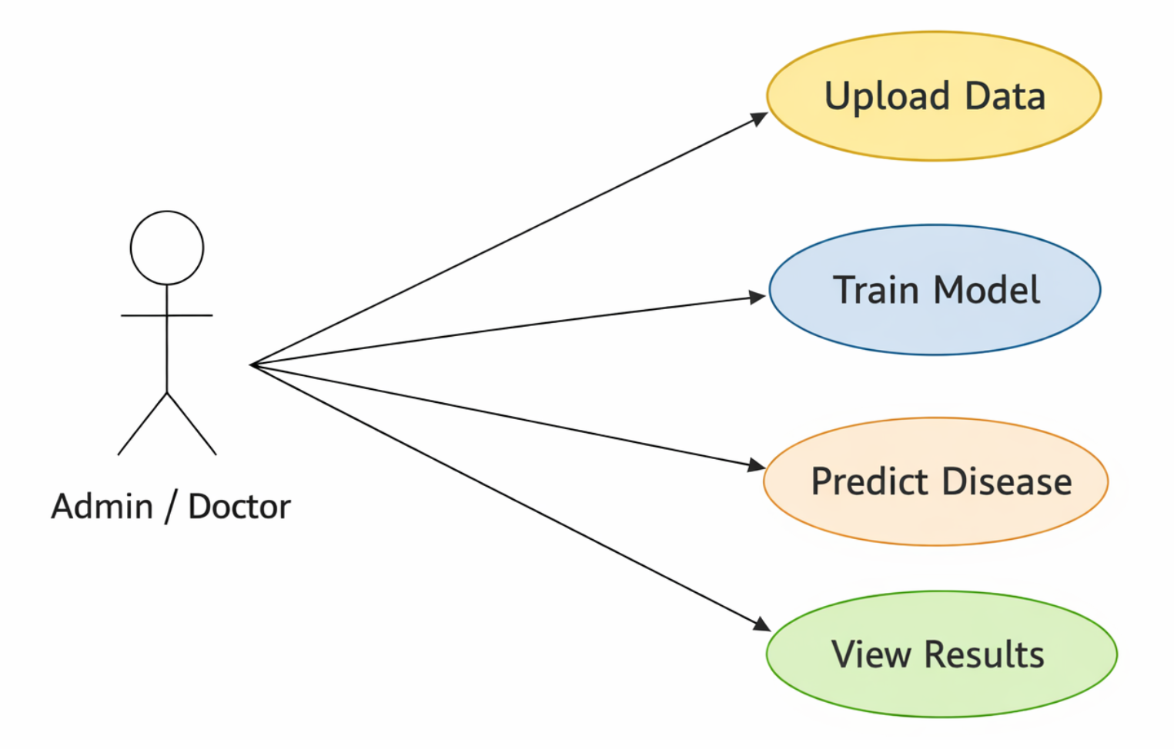
9. UML Diagram

Slide 17
9. UML Diagram
Actor: Admin / Doctor Person who interacts with the system
Upload Data Adds patient data into the system
Train Model Trains the ML/DL model using data
Predict Disease System predicts disease based on input
View Results Displays prediction output

Slide 18
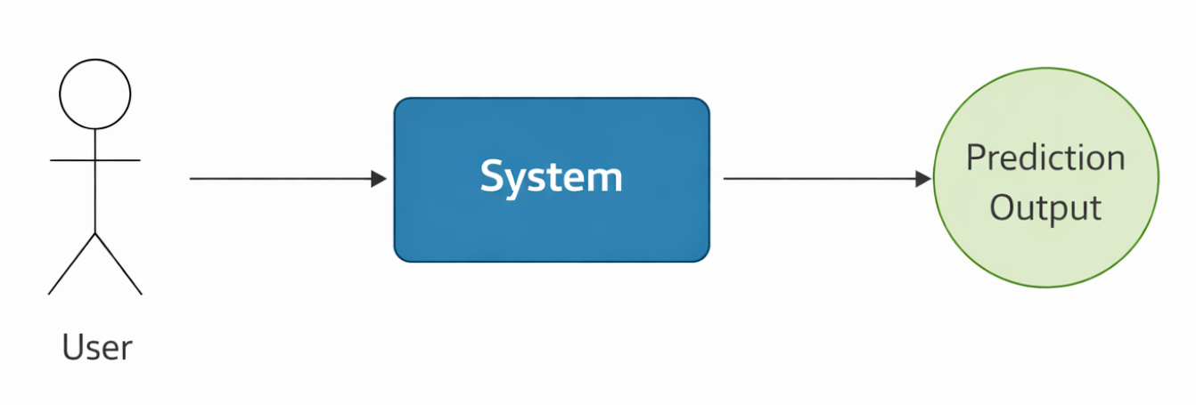
10. DFD Diagram (Level 0)

Slide 19
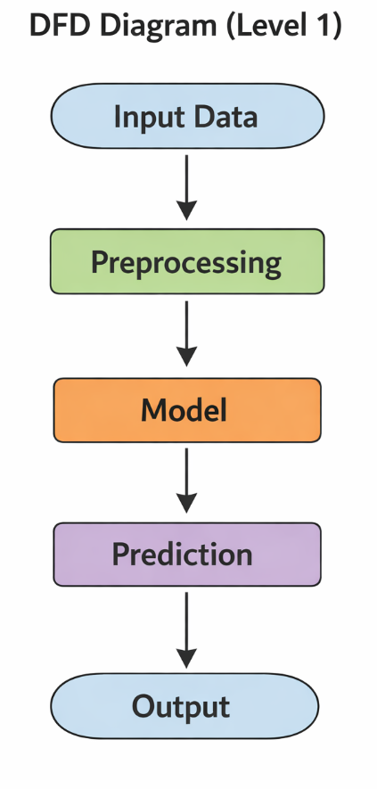
10. DFD Diagram (Level 1)

Slide 20
10. DFD Diagram
Input Data - Raw patient data is collected (reports, symptoms, history)
Preprocessing - Data is cleaned, formatted, and converted into usable form
Model - ML/DL model analyzes the processed data
Prediction - System predicts disease or risk level
Output - Final result is displayed to the user

Slide 21
11. Software Requirement Specification
Functional Requirements
Non-Functional Requirements
Data input and processing
Model training
Prediction generation
Result visualization
Accuracy
Scalability
Security
Performance

Slide 22
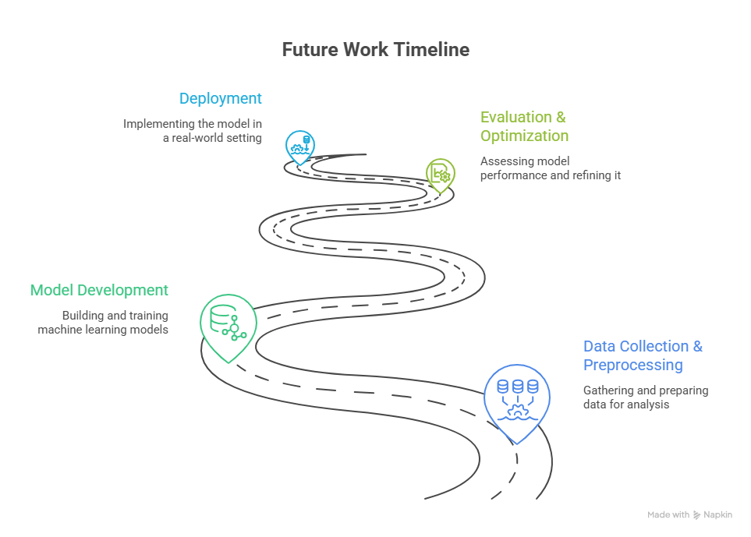
12. Future Work Timeline
Phase 1: Data Collection & Preprocessing Phase 2: Model Development Phase 3: Evaluation & Optimization Phase 4: Deployment

Slide 23
13. Conclusion
Hybrid AI model improves disease prediction
Transformer embeddings enhance text analysis
Explainable AI builds trust
Useful for early diagnosis and healthcare improvement

Slide 24
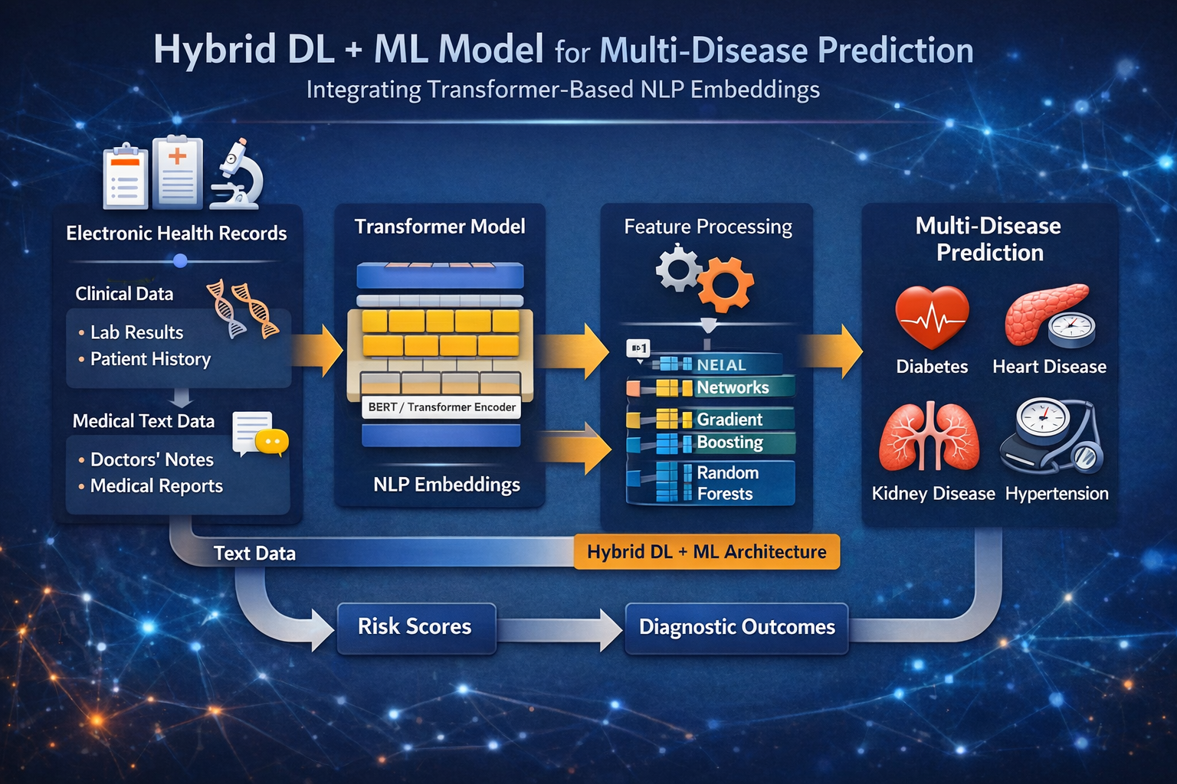

Slide 25

Thank You

